Slide 1
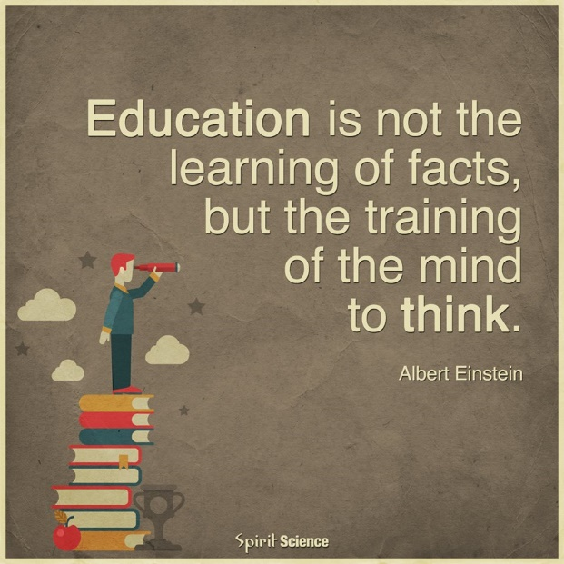
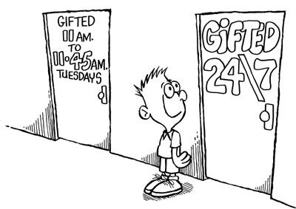
Gifted and Talented Preschooler Identification of gifted and talented preschool children
The development of programme of identification, new teaching methods and a chain oriented approach to prevent underachievement of gifted and talented
Mag. Maruška Željeznov Seničar
maruska@mib.si

Slide 2
Gifted and Talented Preschooler Identification of gifted and talented preschool children
Focus: Strategic partnership
We will develop the methodology for identification of gifted and talented to prevent underachivement young children (3 years)
Book of practical strategies and methodology
Target group in the project: children in kindergarten

Slide 3
Programme
The development of programme of identification, new teaching methods and a chain oriented approach to prevent underachievement of gifted and talented
First day – Vrtec Vrhovci
Tuesday, 26. 1. 2016
14.00 – 18.00
Introduction (participants)
Introduction (programme)
Goals of the teacher training
Teachers view of giftedness and talent
Identification of giftedness and talents in the early years
Second day – Medical chamber of Slovenia
Wednesday, 27. 1. 2016 – conference
8.00 Registration
9.20 -10.30 Dr. Margaret Sutherland UK (Gifted and Talented in the Early years) – EN
11.00 – 11.45 Willeke Rol NL (How to Recognize Gifted Toddlers) – EN
11.45 – 12.30 Dr. Ljiljana Krneta BiH (Holistic approach of creativity in Early Years) – EN
12.30 – 14.30 Lunch and presentation of the book of Dr. Margaret Sutherland
14.30 – 17.00 Workshop Hall D (case studies of Vrtca Vrhovci)
14.30 – 14.25 – Mojca Tomše Challenge - how to watch all the children and
observed each of them
14.25 – 14.50 – Marta Grom Example enabling environment for identifying giftedness
14.50 – 15.15 – Klemen Žerjav Support strategies to develop children potentials
15.15 – 15.40 – Alenka Klenovšek Structural play
15.40 – 16.00 – Ana Češnovar Playing with cardboard boxes
16.00 – 16.25 – Tatjana Taja Guzelj How to recognize giftedness
16.25 – 16.45 – Karmen Majcen Build together

Slide 4
Thrusday, 28. 1. 2016 – Medical chamber of Slovenia
Third day
Free morning
12.30 – 13.30 Lunch (!)
14.00 – 16.30
14.00-15.00 – Milan Hosta PLAYNESS (Motor abilities)
15.00-15.25 – Miša Pintarič Play and magnets
15.25-15.50 – Marinka Novak Curious Ladybugs and Hoses
15.50-16.10 – Maja Robek Harvesting nuts
16.10-16.30 – Petra Tratnik Playing with Wooden Blocks
16.30-17.00 Closing ceremony
Friday, 29. 1. 2016 (9.00 – 16.00) – Vrtec Vrhovci
Fourth day
Practical strategies - workshops
9.00-10.00
Visit kindergarten
10.00 – 11.00
Creativity
11.00-11.30
Break
11.30-13.00
Cognitive – academic/intellectual development
13.00 – 14.00 Lunch
14.00 – 16.00
Learning style
Problem solving
Satuday, 30. 1. 2016 (9.00 – 12.00)
Fifth day – Vrtec Vrhovci
Social and emotional development
Workshop 1 Introduction

Slide 5
Holistic View of Child Development
Development is holistic; it consists of inter-dependent dimensions.
This means that the child’s development cannot be fragmented into health, nutrition, education, social, emotional and spiritual variables. All are interconnected in a child’s life and are developing simultaneously.
Progress in one area affects progress in others.
When something goes wrong in any one of those areas, it has an impact on all the other areas.
Sketch

Slide 6
Teachers view of giftedness and talent
Concepts and Definitions | Respondent Quotes
Multi-category | Children can be gifted in different aspects/ways e.g. mathematically, linguistically, musically, socially, so it is hard to put a percentage on it.
Holistic | A multiple intelligences approach makes for more holistic view of giftedness therefore a holistic assessments is critical, both in EC [early childhood] and in primary education.
Comparative | Giftedness children are those who demonstrate abilities above those of their peer group. They could also be those who demonstrate the potential to achieve above their peers.
Intellectual | A child who has an intellectual grasp of ideas or concepts and who can out it into action or extend the theories beyond regurgitation of facts.
Egalitarian | I believe that given the right environment every child has the potential to be gifted.
Not Labelling | I am wary of labelling and aim to foster the strengths of all.
Qualitative | Gifted children are those who learn faster, see things in different ways from their age peers, exhibit curiosity and understanding which is ‘more than’ others, feel emotions intensely, don’t fit easily – many of these characteristics in one child indicate giftedness to me.
Source: Margrain, V., & Farquhar, S. (2012). The education of gifted children in the early years: A first survey of views, teaching practices, resourcing and administration issues. APEX: The New Zealand Journal of Gifted Education, 17(1). Retrieved from www.giftedchildren.org.nz/apex
Workshop 2 and 3

Slide 7
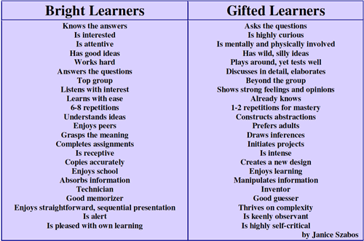

Slide 8
Learning process/information integration
1 Input
2 Processing
3 Memory
4 Output

Slide 9
What to look at “identification” of ability and potencial?
Domain
Cognitive (thinking) skills
Academic giftedness
Learning style
Creative thinking style
Auditory-sequential style
Visual-holistic style
Speech and language skills
Motor abilities
Artistic expression
Musical skills
Social skills
Emotional and behavioural characteristics

Slide 10
What to look at “identification” of ability and potencial? Porter, L. (2005). Gifted young children (2nd edn), Allen and Unwin, Sydney
Domain
Cognitive (thinking) skills | • early achievement of developmental milestones (at least one-third sooner) • quick learning • keen observation of the environment • active in eliciting stimulation from the environment • quick and accurate recall • recall of skills and information introduced some time ago • deeper knowledge than other children • understanding of abstract concepts (e.g. death or time)
Academic giftedness | • read, write or use numbers in advanced ways • show advanced preferences for books and films

Slide 11
Learning style | • responsivity to novel stimuli • speed and efficiency of information processing • openness to new ideas and experiences • motivation and curiosity in a search for understandings • wide-ranging interests • an intense focus on or the ability to immerse themselves in an area of interest, in order to achieve a depth of understanding • longer than usual concentration span on challenging topics of interest (but may ‘flit’ from one activity to another if activities are not challenging enough) • early use of metacognitive skills to manage their own thinking processes • internal locus of control • independence at challenging, non-routine tasks • willingness to take risks • tolerance of ambiguity
Creative thinking style | • imagination • creative problem solving • use of intuition (that is, allowing some of their thinking to occur at a preconscious level) • fluency, which reflects an ability to employ a range or quantity of ideas • flexibility, which refers both to the quality of ideas brought to bear on the problem and to skill at adapting their learning style to the task demands and goals • being nonconforming and rejecting limits

Slide 12
Auditory-sequential style | • learn sequentially: one idea at a time • are analytical: are able to break problems down into their parts • attend well to details • learn well from verbal instructions • are able to carry out instructions to do several things in succession • think logically • have good planning skills • are organised • are less impulsive than agemates • have a clear understanding of cause-and-effect • use rehearsal to remember • once in school, earn reasonably even grades across all subject areas
Visual-holistic style | • learn concepts all at once (holistically) • synthesis ideas: that is, put them together • see the big picture and, correspondingly, may miss details • learn intuitively • have what can only be termed ‘quirky’ organisational systems • learn instantly and so do not benefit from rehearsal or repetition • once in school, obtain uneven grades across subject areas

Slide 13
Speech and language skills | • early comprehension • advanced speech, in terms of vocabulary, grammar and clear articulation • use of metaphors and analogies • ability to make up songs or stories spontaneously • ability to modify language for less mature children • use of language for a real exchange of ideas and information at an early age • a sophisticated sense of humour
Motor abilities | • early motor development, particularly in skills that are under cognitive control such as balance • ability to locate themselves within the environment • early awareness of left and right • facility at putting together new or difficult puzzles • ability to take apart and reassemble objects with unusual skill • ability to make interesting shapes or patterns with objects • advanced drawing or handwriting • high levels of physical energy
Artistic expression | • superior visual memory • engaging with an imaginary playmate in elaborate conversations and games • assigning elaborate characters to dolls or teddies • creating and performing in plays • enjoyment of drama, role playing • advanced skill at drawing, painting or other artistic modalities

Slide 14
Musical skills | • are enthralled by musical sounds • have a deep appreciation and understanding of music (with or without musical performance) • are sensitive to musical structure – tonality, key, harmony and rhythm • appreciate the expressive properties of music – timbre, loudness, articulation and phrasing • have a strong musical memory that permits them to recall music and play it back later either by singing or through an instrument
Social skills | • highly developed empathy for others • less egocentricity: they can deduce the cause of others’ emotions • advanced play interests • early ability to play games with rules • early ability to form close friendships • seek out older children or adults for companionship • withdraw to solitary play if intellectual peers are not available • are often sought out by other children for their play ideas and sense of fairness • leadership skills • early development of moral reasoning and judgment • early interest in social issues involving injustices

Slide 15
Emotional and behavioural characteristics | • emotional sensitivity, intensity and responsiveness • for some, early spiritual awareness • early development of fears • early development of self-concept and awareness of being different • self-confidence in their strong domains • perfectionism, in the sense of having high standards • over-sensitivity to criticism • frustration, which can lead to emotional or behavioural outbursts • acceptance of responsibility usually given only to older children • non-conformity

Slide 16
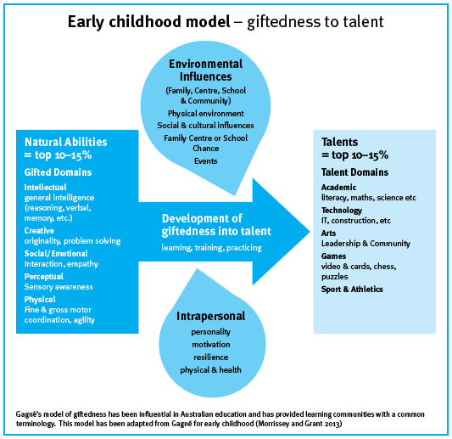
From ability/potential to eminence
Source:
Subotnik, R. F., Olszewski-Kubilius, P., & Worrell, F. C. (2011). Rethinking giftedness and gifted education: A proposed direction forward based on psychological science. Psychological Science in the Public Interest, 12, 3-54.
Should eminence based on outstanding innovation be the goal of gifted education and talent development? Implications for policy and research Rena F. Subotnik ⁎, Rochelle Rickoff American Psychological Association, 750 First Street NE, Washington DC 20002-4242, 202-312-6473, United States

Slide 17
Identifying underachievers
A DISCREPANCY
between
POTENTIAL
(what a child ought to be able to do)
and
ACTUAL PERFORMANCE
(what a child is really demonstrating)
Richert 1991
Functions of human behavior
1 to get
2 to avoid
3 to escape
Richert, E. S. (1991). Patterns of underachievement among gifted students. In M. Bireley, & J. Genshaft, (Eds.),Understanding the gifted adolescent: Educational, developmental, and multicultural issues (139-162. New York: Teachers College Press.

Slide 18
 | To get | To avoid | To escape
The Underachieving Coaster |  | Child who does enough to get by without working too hard or consistently. Avoid responsibility and avoid confrontation at all costs.
The Anxious Underachiever |  | Child who fears failure and never thinks his/her work is good enough. Child may look like worrier.
The Identity-searching Underachiver |  | Child who struggle with themselves to figure out who they are, where they are going and whether the effort will be worth it. They look they are lazy in fact they are drained by the energy it takes to search for they purpose.

Slide 19
The Defiant Underachiever | Child turns everything into a power struggle. They lose their tempers and argue with authority. Freedom and independence.
The Wheeler-dealer Underachiever |  |  | Child is impulsive, charming, and action oriented. They lie, cheat, steal, damage property. Satisfy needs.
Specific learning problems |  | Dysleksia Discalculia Dispraxia
Neurological disorders |  | ADHD Autism Asperger sindrom

Slide 20
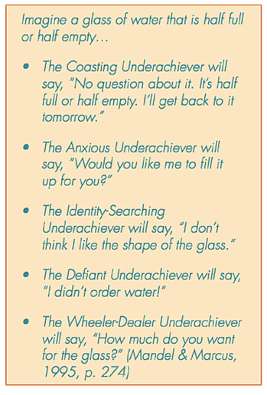

Slide 21
Methods and tehniques of “identification”
1 Nomination of kindergarten teacher
Observation the development of children
2 Nomination of parents
Observation the development of children
3 Testing (?)

Slide 22
Tehniques | Activites
Teachers as Testers | Based on activities in which children typically engage
Played - Based Observation | Nonstructured play Structured Transdisciplinary | • Provides an opportunity to assess behavior of a child who cannot or will not perform in formal testing situation. • More can be seen in observing children at play than in asking them to perform. • All the development domains of a child can be witnessed at the same time.
Child Interviews | Questioning (short) | Book Interview Protocol Describing: What’s happening on this page? Predicting: What do you think will happen next? Problem solving: How else could the character solve the problem? Empathizing: How does the characters feel about what’s happening? Creating: What would you do if you were the character? Recalling: Do you remember what the haracter did first?

Slide 23
Tehniques | Activites
Visual Documentation | Photos, videos
Document Panels | Photographs of children along with their products (e.g., painting, writing, and science collections) are displayed on a board or a panel on the wall of the classroom.
• Objectivity: You must observe each child without judging.
• Confidentiality: You must keep the information you obtain to yourself.
• Recording details: You should look for and record even the smallest details.
• Using direct quotes: You should listen closely and record what each child says.
• Using mood cues: You should describe the emotional mood of the child.

Slide 24
Methods
Anecdotal Records | • Describe what happened in a factual, objective manner; • Telling how it happened; • When and where it happened; • What was said and done. | + 1. The observer needs no special training to record. 2. The observation is open ended. The recorder writes anything and everything he or she witnesses and is not restricted to one kind of behavior or recording. 3. The observer can catch an unexpected incident no matter when it occurs, for it is usually recorded at a later time. 4. The observer can look for and record the significant behavior and ignore the rest. - 1 It does not give a complete picture because it records only incidents of interest to the observer. 2. It depends too much on the memory of the observer because it is recorded after the event. 3. Incidents may be taken out of context and thus be interpreted incorrectly or used in a biased manner. 4. It is difficult to code or analyze narrative records; thus, the method may not prove useful in a scientific study.
Running Records | • Facial expressions • Interactions with materials • Interactions with people • Body movements • Body langauge • Spoken language • Attention span | Record is beneficial because it allows us to record minute details, but it is not considered practical when trying to collect a great deal of information about a child. To discover causes and effects of behavior; for case conferences; to plan for individuals

Slide 25
Observer Errors | Insufficient Evidence | Was anything overlooked or omitted?
Omitting or Adding Facts | Omitting some of the facts Recording things that did not happen Recording things out of order | • Record only the facts. • Record every detail without omitting anything. • Do not interpret as you observe and record. • Use words that describe but do not judge or interpret. • Record the facts in the order that they occur.
Learning Center Logs | A small spiral notebook on the top of the room divider for each learning center | Teacher can piece together a record for more than one child’s entire day of activities as seen by several different observers.
Event Sampling | A brief narrative of conditions preceding and following specified behavior, recorded while behavior is occurring | + It keeps the event or behavior intact, making analysis easier. 2. It is more objective than some methods because the behavior has been defined ahead of time. 3. It is especially helpful in examining infrequent or rarely occurring behaviors. - It takes the event out of context and thus may minimize other phenomena that are important to the interpretation. 2. It is a closed method that looks only for specified behavior and ignores other important behavior. 3. It misses the richness of detail that anecdotes, specimen records, or running records provide.
Rating Scales | A scale of traits or behaviors with checkmarks, recorded before, during, and after behavior occurs.

Slide 26
Checklists | A list of behaviors with checkmarks, recorded before, during, and after behavior occurs | + Efficient for observing more than one child at a time for many behaviors; useful for an individual during a period of time; a good survey or inventory tool; useful for several observers at once; no special training needed - Closed; limited to specified behaviors; no information on quality of behavior
Time Sampling observations | Records the frequency of a behavior’s occurrence over time.
Rubrics | Set of guidelines that evaluate performance. Holistic Rubric Analytic Rubric Developmental Rubric | Attention Span 1—Rarely finishes task, moves rapidly from one task to another 2—Usually needs encouragement to stay with task until complete 3—Can usually remain with task appropriate to age level until it is finished 4—Can stay with a chosen activity for very long periods, even returning next day 1—Gets up and leaves before starting task; 2—Starts a task but leaves before finished; 3—Stays with task for a while before leaving; 4—Stays with task almost to the end before leaving.

Slide 27
Focusing questions
What are differences between watching and observation?
What is child observation?
Why do we observe children?
What can we see or cannot?
What can learn from observing children?
How can we improve teaching practices through observing them?

Slide 28
Identification process
1 Decision (why, what, who, when, how, purpose, vision)
2 Choosing the method/s and the topic of the evaluation
(quantitative, qualitative)
3 Collect the data/material (questionaries, videos, photos, check list …)
4 Interpretation of data and material
5 Prepare the plan for children (goals (process or goal oriented), activities, resources), parents
6 Evaluation

Slide 29
Spontaneous game – children game (Flow – Optimal experience)
Challenge which can be accomplished.
Concentration is total …
Goals are clear
Feedback is immediate
We gain complete focus
Sense of control
No room for preoccupation with the self
We are free from tyranny of time
Low skills, high challenges = anxiety
Low challenges, high skills = boredom
High challenges, high skills = FLOW
Mihaly Csikszentmihalyi, "Flow: The Psychology of Optimal Experience", New York: Harper & Row, 1990.

Slide 30
Strategies – gifted child
Emotional – social strategies
- Attachment/Relationship
- Relaxing techniques
- Turtle technique

Slide 31
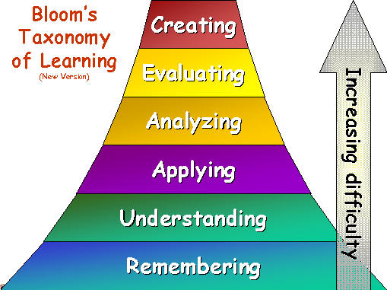
Strategies – gifted child
Cognitive – academic giftedness
Questions (new Bloom taxonomy)

Slide 32
Strategies – gifted child
Creative learning style
OTHER USE New options? Modified? What other ideas?
CHANGE Turn around? Change meaning, color, motion, sound, names, forms ...? Other changes?
INCREASE What to add? More what? Greater frequency? Harder? Higher? Longer? Additional content? Doubling? Multiplying? Exaggeration? Smaller? More compact? Minimized? Lowered? Short? Reduce weight? Drain - eliminated? Divide?
REPLACE. what instead? Other ingredients? Another material? Another process? A different approach? Another tone or voice?
TRANSFORM Replace components? Different appearance? A different sequence? Replacing the cause of the result?
RETURN to replace the negative with the positive, or vice versa? What about conflicts? Replace the starting point? To change the application? See the other side? What about taste, composition, aroma, assortment ...?
COMBINING Combining units? Combining purposes or ideas?

